Slide 1
Restrictive cardiomyopathy

Slide 2
Outline :
Definition
Epidemiology
Classification
Genetics & Etiology of RCM
Clinical characteristics
Diagnostic evaluation
Management

Slide 3
definition
Disease of heart muscle with restrictive physiology
Stiffened or non-compliant ventricle → severe diastolic dysfunction & ↑ ventricular filling pressures
Normal systolic function
Normal or ↑ wall thickness ( in infiltrative causes)
Normal LV cavity & biatrial enlargement

Slide 4
Epidemiology
Least common form of cardiomyopathy
5% in adults & 2.5 to 5 % in children – of all CMP’S
Prevalance depends on regional distribution
Endomyocardial fibrosis (m.c in world & tropical / subtropical countries)
Amyloidosis (m.c in united states)
More female preponderance

Slide 5
Classification
Based on etiology – primary & secondary
Primary include idiopathic, familial & endomyocardial fibrosis
Secondary forms include infiltrative diseases, storage disorders, metastatic & iatrogenic causes

Slide 6
Notes:
Toxic effects of anthracycline; Drugs causing rcm serotonin, methysergide, ergotamine, mercurial agents, busulfan

Slide 7
Genetics of rcm
Gene Mutations associated with RCM phenotype include Sarcomeric & Non-sarcomeric protein defects
Modes of inheritance: AD, AR, X-linked & denovo ( rare)
Many families have common gene defect but different phenotypic expression ( eg: TNNI3 – Troponin I mutation – express RCM and HCM phenotype)

Slide 8
Mutations reported in association with rcm
Notes:
Troponin t (TNNT2); ACTC ;

Slide 9
Etiologies :
Idiopathic RCM
Seen from infancy to adulthood
Poor prognosis especially in children
Genetically determined or familial in most cases
Atrial fibrillation is common

Slide 10
Cardiac amyloidosis:
Infiltrative cardiomyopathy
MC types associated with cardiac amyloidosis – AL; ATTRw; ATTRm and Localised atrial amyloidosis
Clinical pattern, prognosis & management depend on type

Slide 11
AL type has clinically significant cardiac involvement in upto 75%
Rapidly progessive heart failure along with systemic disease (survival time ≤ 9 m)
Familial amyloidosis (ATTRm) –autosomal dominant;
Involve both heart and peripheral nervous system
Young pts – predominant peripheral nervous system;
Middle age pts –predominant cardiomyopathy

Slide 12
Senile systemic amyloidosis( ATTRw):
Almost always involve the heart;
Mostly seen in elderly (>70 yrs)
Male to Female ratio is almost 20:1
Isolated atrial amyloidosis(IAA) involve cardiac atria of diseased hearts

Slide 15
Sarcoidosis:
Predominant & MC phenotype is DCM ; but RCM is frequently described
Women > Men
Most pts have evidence of non-cardiac disease;
Isolated cardiac disease is rare and presents as heart block & ventricular arrhythmias

Slide 16
Storage disorders
Fabry’s disease :
Lysosomal storage disorder; X linked recessive
Deficiency of alpha-galactosidase A enzyme
Manifests with acroparesthesias, angiokeratomas, TIA/ Stroke due small vl disease
Cardiac involvement apparent in 3rd to 4th decade
Manifests as LV hypertrophy , worsens with age

Slide 17
Hemochromatosis : primary & secondary forms
Multiple organ involvement is seen
Cardiac involvement begin with restrictive non-dilated progressing to systolic dysfunction
and eventually develop DCM
Associated with arrhythmias and conduction system disease

Slide 18
ENDOMYOCARDIAL FIBROSIS (EMF)
MC cause of RCM worldwide (more in Africa , south asia)
Males > females; Bimodal age distribution
Characterized by fibrosis of the RV and LV apices and subvalvular apparatus
No unifying cause is found
Pathology resemble similar to eosinophilic cardiomyopathy

Slide 19
Loffler (Eosinophilic) endocarditis
Occurs within spectrum of hypereosinophilic syndromes
Hypereosinophilia defined as chronic AEC > 1500 cell/ml for at least 1 month
Cardiac involvement categorized into acute, intermediate and fibrotic stages
Acute phase : few or no signs/ symptoms; myocardial inflammation & necrosis
ECHO will be normal; Only CMR with contrast can detect disease along with ↑ cardiac biomarkers
Notes:
Causes are helmimthic and parasitic infections, malignancy, leukemia, allergy and drug reactions

Slide 20
Intermediate stage : thrombus favouring endocardium at apices; mitral / tricuspid regurgitation & heart failure
Thromboembolism to brain & other organs is common
Fibrotic stage : diffuse scarring → endomyocardial fibrosis & RCM
Scarring also involve mitral/ tricuspid sub-valvular & leaflet structures → regurgitation

Slide 21
Carcinoid heart disease
Part of carcinoid syndrome – metastatic neuroendocrine tumor
Hepatic mets release elevated vasoactive substances especially 5-HT
Involve Rt heart predominantly
Myofibroblast proliferation & collagen deposition →right sided valve thickening and retraction
Pulmonary root constriction, tricuspid annular and subvalvular involvement also seen
High levels of 5-HT in Rt heart causes progressive fibrotic endocardial plaque

Slide 22
Notes:
Tricuspid valve in carcinoid heart disease. Left panel, Transesophageal echocardiogram showing thickened tricuspid valve (TV) leaflets and endocardial
thickening as a result of carcinoid plaque (dashed arrow). Right panel, Surgical specimen of the TV showing thickened, retracted papillary muscle as a result of carcinoid
plaque and thickened chordae (dashed arrow)

Slide 23
Pathophysiology :
↑Ventricular stiffness & compliance→ impaired relaxation & restrictive filling → marked pressure increase with small vol. rise → diastolic dysfunction
Rapid rise in ventricular filling pressures during exercise → limited stroke vol. → syncope/ angina / DOE

Slide 24
Atrial enlargement → development of atrial arrhythmias & secondary AV valve regurgitation
Thromboembolic complications seen with or without AF

Slide 25
Clinical features:
Symptoms of heart failure – DOE, exercise intolerance, fatigue, syncope and angina (rare)
Physical findings: predominant right heart failure features –
Raised JVP with prominent X and Y descent (Kussmauls sign)
Irregular pulse- atrial fibrillation

Slide 26
Apex beat – usually palpable, may be mildly displaced
Heart sounds- S1, S2 normal, S4 gallop frequently heard except in amyloidosis
Murmurs- usually not heard, MR & TR seen in some
Hepatomegaly, ascites and marked pedal edema

Slide 27
Diagnostic evaluation
ECG :
Right and left atrial enlargement (MC); Non-specific ST-T changes; conduction abnormalities
Atrial fibrillation is common;
Low voltage limb leads with Pseudo-infarction pattern in inferior & septal leads seen in cardiac amyloidosis

Slide 28
Holter study :
Useful esp. in children for Rhythm evaluation & ST segment analysis
Studies done by Rivenes et al and Greenway et al reported rate related ST segment depression in patients with anginal episodes/ arrhythmias
On contrary, Hayashi et al didn’t find any coronary abnormalities by catheterization and perfusion defects by exercise testing
Notes:
most common
cause of ischemia in this patient population would be relatively\ diffuse
hy\poperfusion of the subendocardial my\ocardium due to the high diastolic filling
pressures impairing coronary\ perfusion, and not coronary\ abnormalities per se
Cardiac MRI with delay\ed enhancement
might be a better tool to further investigate this mechanism.

Slide 29
Approximately 15% of pediatric population had arrhythmias & conduction disturbances
Atrial flutter was MC reported followed by high degree second and third degree heart block
Longer PR interval and longer QRS duration were associated with acute cardiac events

Slide 30
echocardiography
Intial step in the diagnosis
2D ECHO:Typical features in RCM incudes :
Normal RV and LV EF;
Normal RV and LV chamber volumes & wall thickness ;
(exception → wall thickness increased in infiltrative conditions)
Biatrial enlargement
Notes:
Increased early diast. Filling velocity E & decreased atrial filling velocity A

Slide 31
Doppler ECHO findings (s/o restrictive filling parameters) are as follows:
Increased E/A ratio > 1.5
Decreased mitral deceleration time (DT < 120ms)
Decreased IVRT (isovolumetric relaxation time)
Decreased PVs/PVd ratio (pulmonary venous flow velocities)
Augmented atrial reversal velocity (PVAr)

Slide 32
Doppler tissue imaging (DTI):
Reduced mitral anular velocities (e’)
Increased E/e’ ratio
Hepatic vein doppler:
Increased diastolic forward flow reversal with inspiration

Slide 33
Echocardiographic Findings in Restrictive Cardiomyopathy
Notes:
(Upper left panel) Pulsed-wave Doppler of the mitral inflow, which demonstrates a restrictive pattern, with early diastolic mitral inflow
Doppler velocity (E) greater than late velocity (A) and short deceleration time. (Upper right panel) Hepatic vein pulsed-wave Doppler
showing increased inspiratory forward velocities (arrow), inspiratory diastolic flow reversals (arrowhead), and minimal expiratory diastolic
flow reversals (rounded arrow). (Lower left panel) Lateral mitral annulus tissue Doppler demonstrating markedly reduced early diastolic
velocity (eʹ). (Lower right panel) Apical 4-chamber 2-dimensional echocardiogram revealing marked biatrial enlargement

Slide 34
Disease specific ECHO findings:
Amyloidosis : ↑ RV and LV wall thickness
very fine granular or scintillating echobright appearance of myocardium with preserved LVEF
Diffuse thickened AV valves with severe biatrial enlargement (owl eye appearance)
Doppler tissue imaging- severly impaired longitudinal LV systolic function with normal EF
Speckle tracking – regional longitudinal dysfunction with apical sparing

Slide 35
Notes:
Echocardiogram in a patient with AL amyloidosis. Parasternal (left) and apical four-chamber (right) views in the
same patient as in A are shown. Concentric wall thickening and biatrial enlargement with a pericardial effusion are evident

Slide 36
This appearance represents a gradient of longitudinal strain from the apex to the base with relatively well-preserved apical strain and severely impaired basal strain.

Slide 37
Echocardiogram demonstrating biventricular myocardial thickening and biatrial enlargement.
(B) Strain imaging with markedly reduced global averaged
peak longitudinal systolic strain with apical preservation (‘bullseye”) pattern, typical of cardiac amyloidosis.
(C) Cardiac magnetic resonance with
global subendocardial LGE
(D) PYP scan shows severely increased myocardial uptake (grade 3, greater than bone) consistent with ATTR cardiac
amyloidosis

Slide 38
Haemochromatosis:
LA, LV dilatataion
Normal LV wall thickness
Global hypokinesia
Initially restrictive pattern progressing to systolic dysfunction

Slide 39
Fabrys disease:
Concentric LVH
Mitral leaflet thickening with significant MR
Endomyocardial fibrosis:
Hallmark feature- formation of diffuse thrombi along the endocardium in apices
Thrombus obliterating the ventricular cavity
Retraction of AV valves → incompetence

Slide 40
4 chamber view with thrombosis/fibrosis obliterating the right ventricular apex in EMF
4 chamber view with severe mitral regurgitation due to deformed valve

Slide 41
Cardiac MRI
Important diagnostic tool for assessment of pericardial and myocardial disease
Typical features of RCM on CMR- normal volume ventricles with marked atrial enlargement

Slide 42
Disease specific CMR features
Cardiac amyloidosis:
Diffuse circumferential subendocardial LGE
Shows restrictive morphology with reduction of systolic thickening in LGE segments
Absent myocardial edema with diffuse perfusion defects seen
Thickened atrial valves with atrial LGE
Loss of atrial contraction (absent S4 clinically)

Slide 43
Endomyocardial fibrosis:
Dilated hypocontractile LV and RV
Absence of myocardial edema
Normal myocardial perfusion
Diffuse subendocardial LGE of LV/RV with/without thrombus
Obliterative LV or RV apex

Slide 44
Cardiac sarcoidosis:
Multifocal intense LGE often in septum inferolateral valve of LV, right atrium and RV free wall
RWMA with hypocontractile LV/RV
Patchy bright regions s/o myocardial edema
Normal myocardial perfusion

Slide 45
Above CMR demonstrating abnormal LGE consistent with scarring
Below FDG-PET s/o active inflammation around the scar in sarcoidosis

Slide 46
Haemochromatosis:
Hypocontractile LV with dark myocardium
Absence of myocardial edema
Normal myocardial perfusion
Normal LGE mapping

Slide 47
Fabrys disease:
Concentric LVH
RWMA with wall thinning
Absence of myocardial edema
Normal myocardial perfusion
Midwall LGE in inferolateral wall

Slide 48
Cardiac catheterization
Elevation of right and left filling pressures with reduction in cardiac index
RAP is elevated with prominent X and Y descents
Square root sign (early decrease followed by rapid rise to plateau phase in ventricular diastolic pressure)
LVEDP ≥ 5mm Hg than RVEDP : RVSP > 50mm Hg
Concordance of intracavitary and intrathoracic pressures

Slide 49
Simultaneous RV and LV Hemodynamic Assessment Constrictive Pericarditis and Restrictive Cardiomyopathy
Notes:
(Top) Left ventricular (LV) (blue) and right ventricular (RV) (orange) hemodynamic pressure tracings in constrictive pericarditis. End-diastolic
filling pressures are elevated, and a “square root” sign is present on both tracings (*). Enhanced ventricular interdependence is present,
demonstrated by visualization of the systolic area index, RV (light gray) and LV (dark gray) areas under the curve for both inspiration (Insp)
and expiration (Exp). During inspiration, there is an increase in the area of the RV pressure curve and a decrease in the area of the LV pressure
curve. (Bottom) LV and RV pressure tracings in restrictive cardiomyopathy. End-diastolic pressures are elevated and a square root sign (*) is
seen; there is no evidence of enhanced ventricular interdependence, with parallel changes in LV and RV pressure curve areas.

Slide 50
Endomyocardial biopsy
Important role in the diagnostic evaluation of diseases with restrictive physiology
Class II a recommendation by AHA/ ACC
RV biopsy is most commonly done
Useful in identifying the exact etiology of RCM for targeted therapy

Slide 51
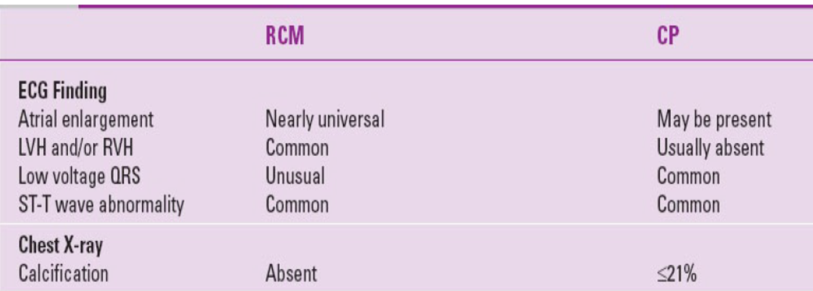
Restrictive cardiomyopathy VS constrictive pericarditis

Slide 52
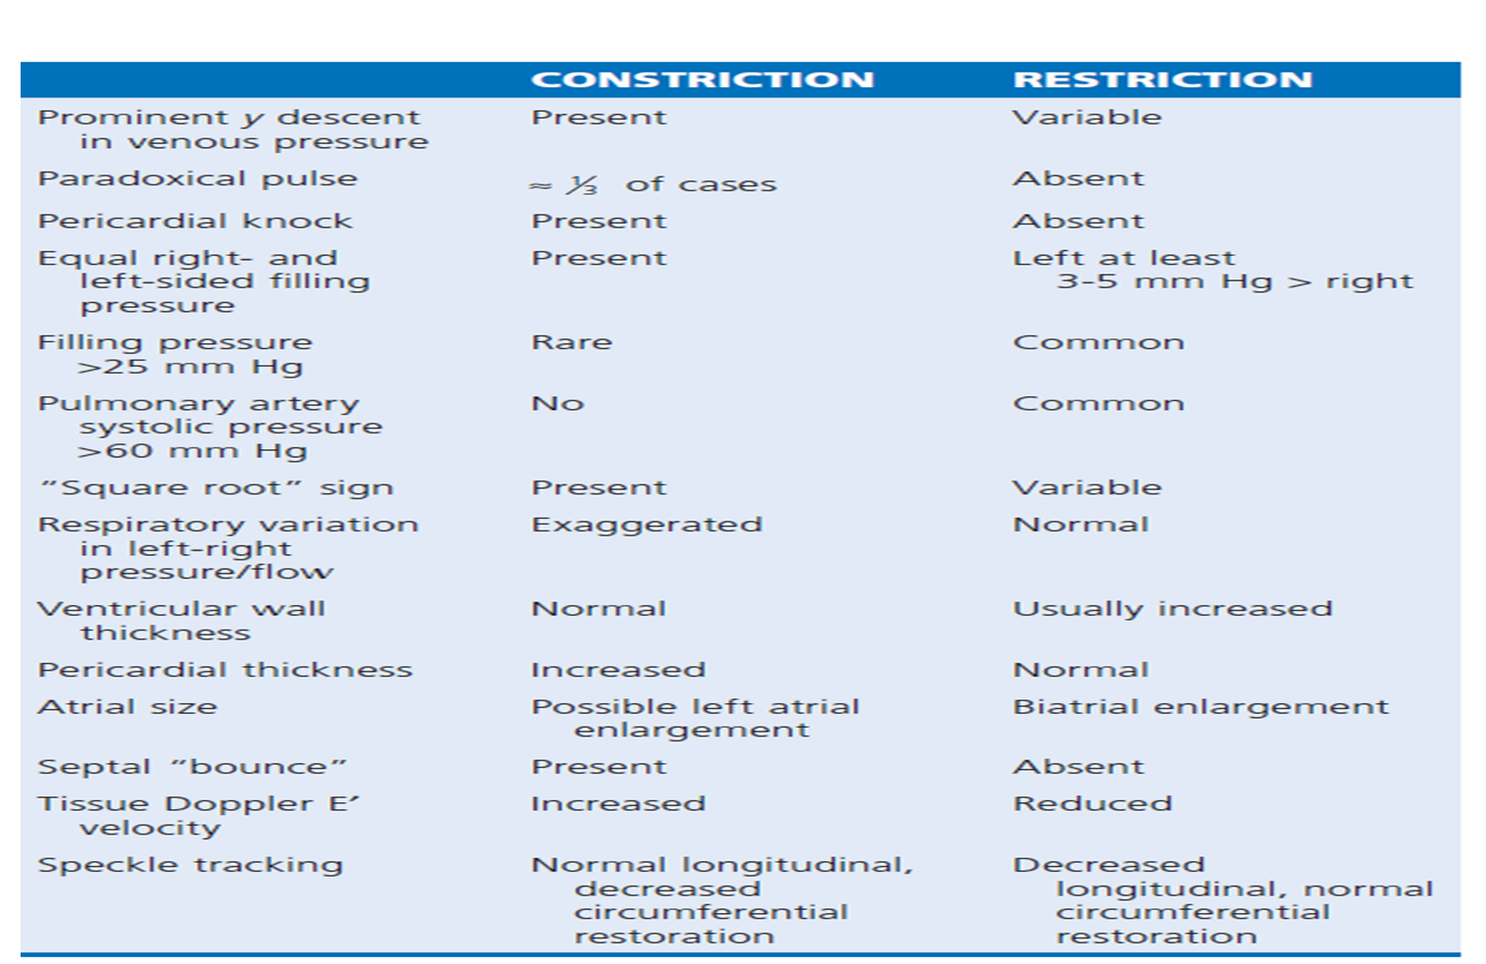

Slide 53
Management
General Treatment Principles:
Relieve congestive symptoms and avoid hypotension
Diuretics
Salt restriction (2-4 gms/day), fluid restriction to less than 2 litres
Rx of AF with rhythm control rather than rate control improves diastolic filling
No pharmacological treatment prolongs survival

Slide 54
Disease specific treatment
Cardiac amyloidosis:
AL amyloidosis- chemotherapy, autologous stem cell transplantation and monoclonal antibodies (daratumumab) targeted against plasma cell dyscrasias
Beta blockers, ACEI/ ARBs poorly tolerated
CCBs contraindicated (worsens heart failure)
High degree AV block may require permanent pacemaker- biventricular pacing preferred

Slide 55
Familial amyloidosis (ATTRm):
Liver/ heart-liver transplantation and tafamidis (TTR stabilizer)
Senile systemic amyloidosis (ATTRw):
Gerneral treatment principles + tafamidis

Slide 56
Cardiac sarcoidosis:
In patients with heart failure Prednisolone 1mg/kg tapered over several months is recommended
High degree AV block require ICD- pacemaker implantation
Heart transplantation in treatment refractory pts

Slide 57
Fabry’s disease : enzyme replacement will reverse phenotype
Hemochromatosis : iron chelation therapy ; frequent phlebotomies
Carcinoid heart disease: hepatic mets debulking ; use of octreotide – tumor shrinkage; advanced valve disease is surgically corrected
Hypereosinophilic syndromes: early stage-steroids are useful;
advanced valve disease – surgically corrected

Slide 58
Thank you

